Slide 1

Donor analysis and marketing strategies
Surbhi Sharma
Notes:
This presentation focuses on donor analysis and marketing strategies

Slide 2
Table of content
Descriptive Analysis
Key Demographics of Highly Valued Donors
RFM Segmentations of Current Donors
Promotional Plans
Recommendation
Notes:
Topics to cover in the presentation -
1) Restate the mandate we set up from the very beginning
2) improve sustainability of donations in the status quo
Based on these two goals, we built our analytics structure and designed the promotional plans

Slide 3
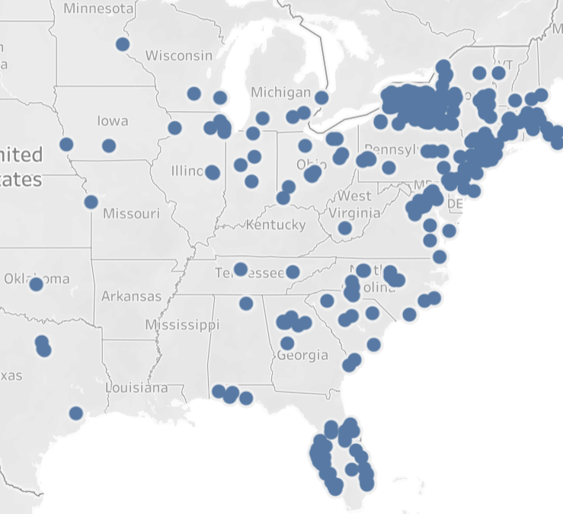
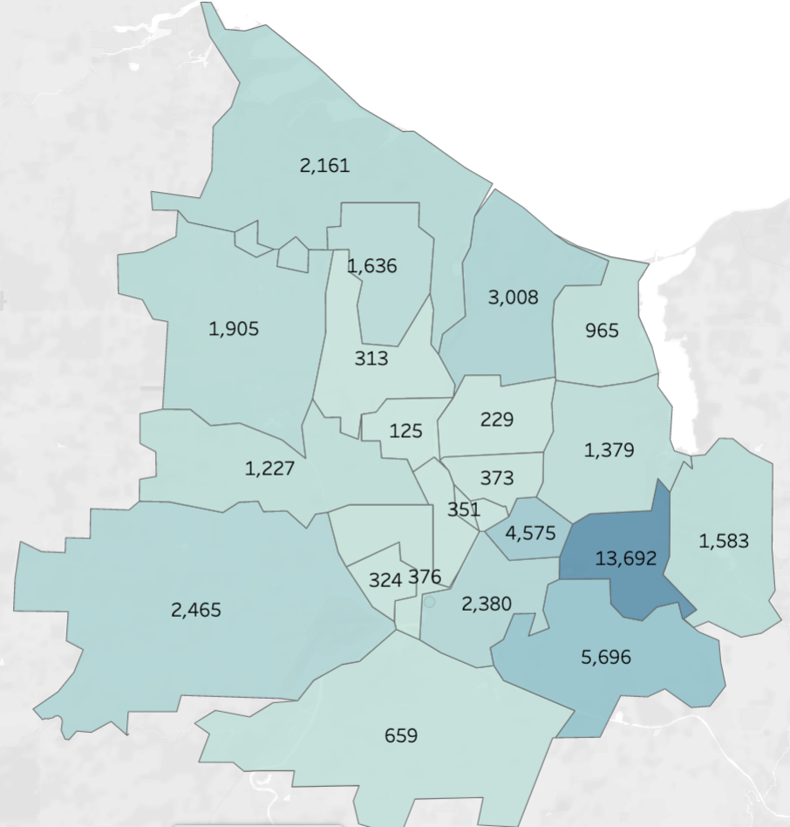
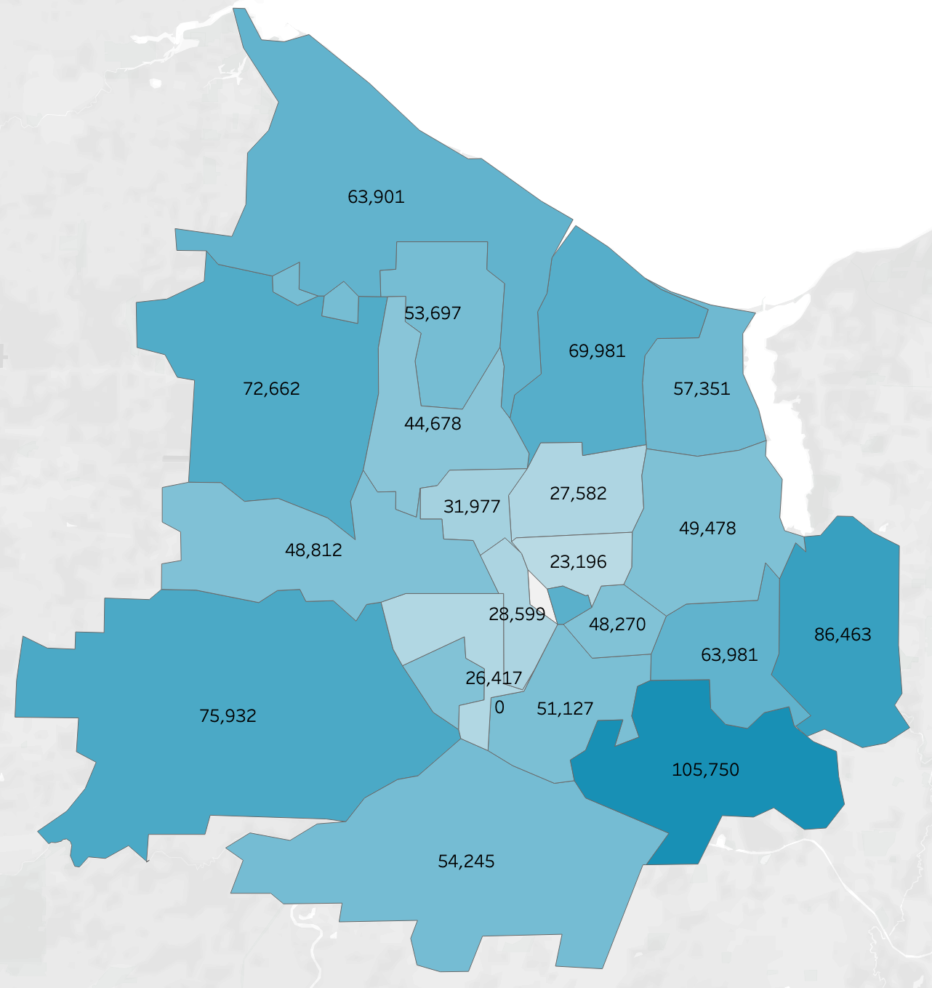
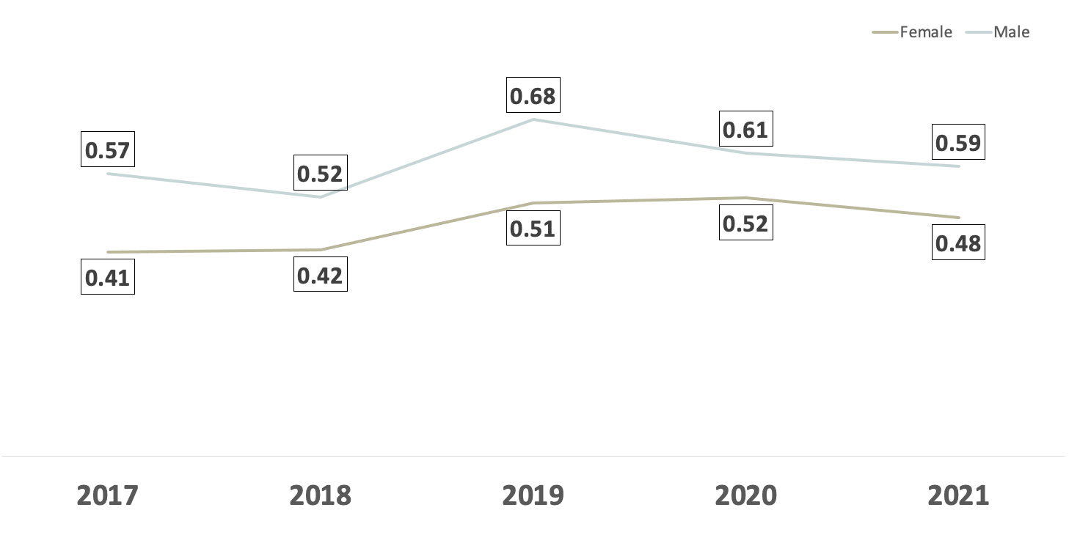
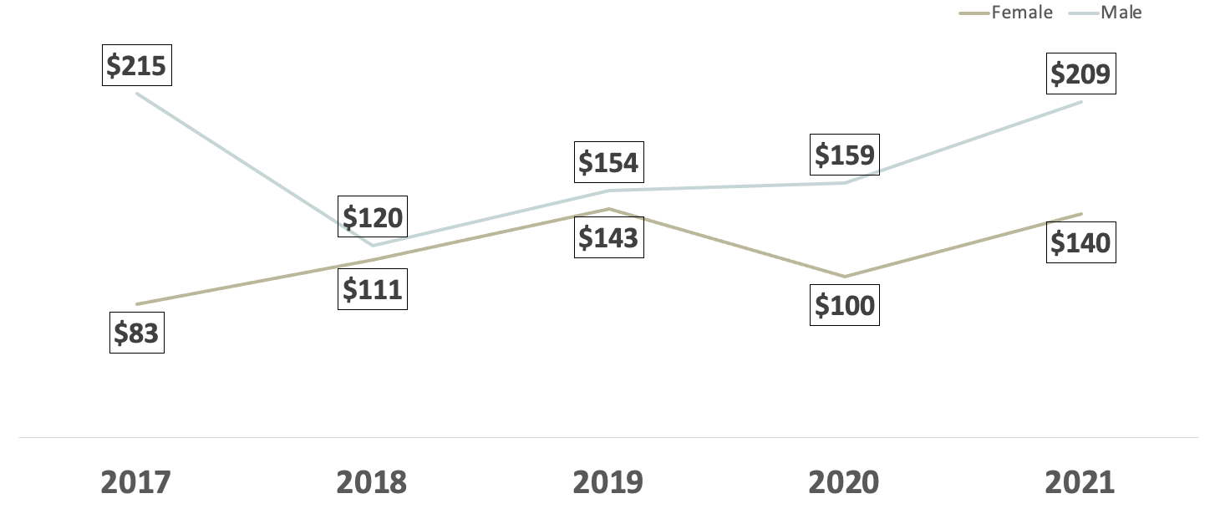
Descriptive analysis crosstabs and Key findings
Random Large Gifts Came from outside-ROC
Zip code | Gifts # | Gifts $$ | Donors #
29451 | 2 | $14,500 | 1
48059 | 0.4 | $2,500 | 1
80112 | 0.2 | $2,000 | 1
37204 | 3.6 | $1725 | 1
07042 | 4.2 | $680 | 1
22180 | 0.2 | $660 | 1
60645 | 1.2 | $580 | 1
Snowbirds in Florida
South Carolina
Michigan
Colorado
Tennessee
Virginia
Illinois
Female gave steadily
Male gave more frequently and a higher amount
Gender Difference in Average Gifts Numbers and Amount (17'-21')
Similarities in Gift Amount Distributions and Income Level Distributions
Notes:
Interesting findings during exploring the data are selected as follows:
From distribution map of current donors, we find a small number of donors are from the southeastern part of United States, we take a reasonable guess that these are snowbirds in Florida
We also built the map of income level and donations, and we spotted the similarities in Rochester Area
While exploring this data of large donations, I found random large gifts were dropped by people living in NY States but outside Rochester
And when we compare the donation from male and female, we kind of see that males are giving more frequently and higher amounts.
The attributes we were focusing on at this stage were all tested and included during the modeling process

Slide 4
Key demographics of donors indicated by regressions
GENDER = M
Males donate 27% more amount than females.
INCOME ⇧
A 10% increase of income is likely to contribute to 3% increase of gift amount
EDUCATION ⇧
People with bachelor’s degree or above donate 103% more amount than those who don't.
People with bachelor’s degree or above donate 103% more amount than those who don't.
DIVERSITY ⇧
People who live in areas with greater diversity donate 44% more.
Notes:
And based on the descriptive analysis I produced the model to find the key demographics of a valuable donor
And I found four attributes that play significant role in increasing the donation amount
Specifically, they are: being a male, having a higher income, living in a highly educated, and diversified community
However these attributes have very different degree of impacts
And its surprising to see that people with bachelor’s degree or above may donate twice as many money as those without the bachelor’s degree.

Slide 5
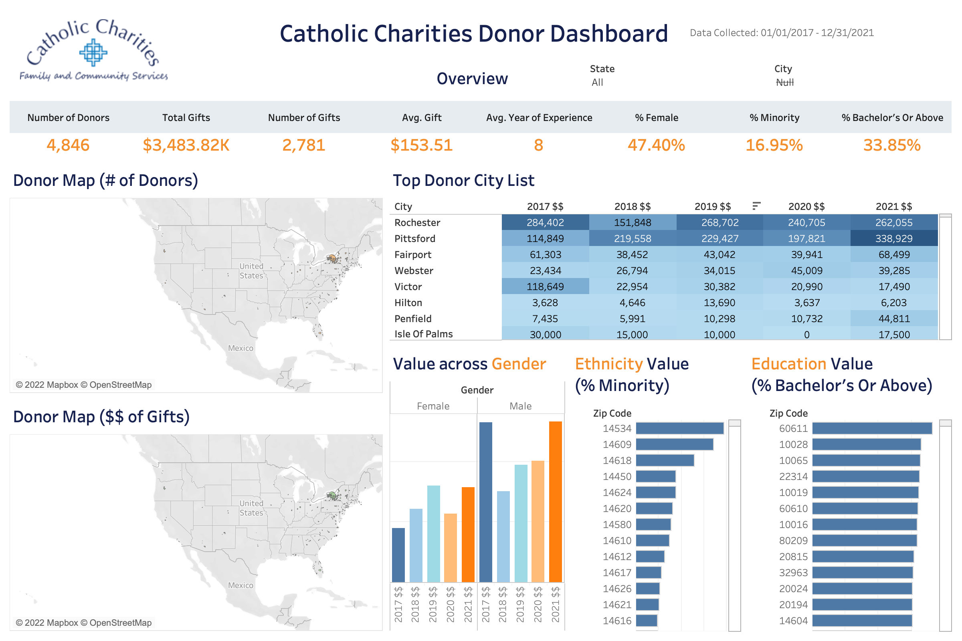
Donor Dashboard
FILTERS
OVERVIEW
MAPS
DEMOGRAPHICS
Notes:
For the internal analytics and reporting purposes, a demo dashboard has been built for Catholic Charities
And it has four basic sections:
The overview section with many key performance indicators like number of donors and amount of donations
The maps that are showing geographic distributions of our current donors and value donors
The third section is showing different demographics information and city list of top donation over the five years
On the upper right corner, there are filters for states and cities. We can apply the filters to compare the performances across regions
After we know the characteristics of our valuable donors, we’d like to use the traditional RFM tools to segment our current donor profile.

Slide 6

Segmentation based on RFM Model
Three rules of segmentation based on RFM
Recency: whether this person has donated in 2021 or 2022 ​
Frequency: whether this person donates more gifts than the average
Monetary value: whether this person donate more money than the average ​
Based on the rules above, we have 6 segments:​
"CORE", "LOYAL", "WHALES", "PROMISING", "ROOKIES", "SLIPPING"
Notes:
Regression model helped in identify some key variables. In the following part, we are going to cluster our donors into different segments based on the RFM model. This segmentation combined with insights from regression model will further help us design more customized marketing strategies to target our donors.
RFM model has three important elements, recency, frequency, and monetary value. Here, we define 'recency' as whether there is any donation behavior in 2021 or 2022. If the answer is yes, then we will label it as 1, otherwise a zero. As for frequency, we calculate the average gifts donated by all donors from 2017 to 2021 and then compare each donor's number of gifts with this average. If above average, then 1, otherwise 0. We process the monetary value using the same way.
Thus we got matrix with 1 and 0. Based on the results, we finally group our donors into 6 segments.

Slide 7
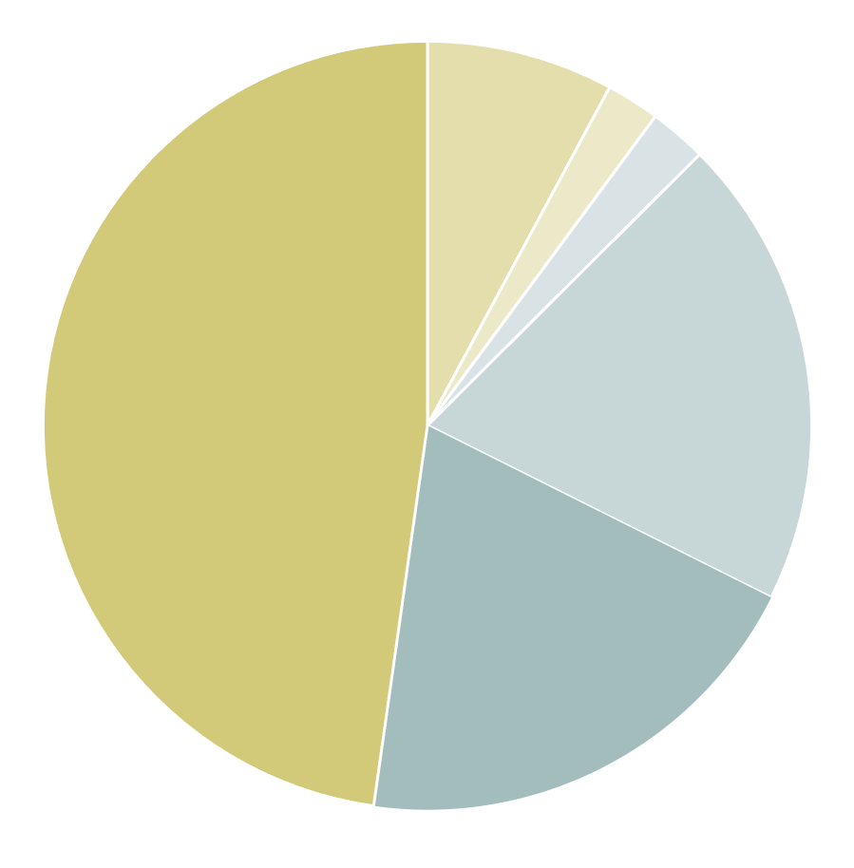
Segmentation based on RFM Model
Our 6 segments:​
"PROMISING" Not everyone is rich, but everyone can do charities!
Recency=1/0, frequency=1, monetary value=0
27.75%
2.56%
"WHALES" How generous! Please come often!
Recency=1/0, frequency=0, monetary value=1
"ROOKIES" Yeah! We got some new donors
Recency=1, frequency=0, monetary value=0
23.41%
2.06%
"LOYAL" Hey! Please don't forget us!
Recency=0, frequency=1, monetary value=1
6.98%
"CORE" Whoa, here are our best donors!
Recency=1, frequency=1, monetary value=1
47.22%
"SLIPPING" Opps, they just left us!
Recency=0, frequency=0, monetary value=0

Slide 8
Segmentation based on RFM Model
Our 6 segments:​
"PROMISING" Not everyone is rich, but everyone can do charities!
Recency=1/0, frequency=1, monetary value=0
27.75%
2.56%
"WHALES" How generous! Please come often!
Recency=1/0, frequency=0, monetary value=1
"ROOKIES" Yeah! We got some new donors
Recency=1, frequency=0, monetary value=0
23.41%
2.06%
"LOYAL" Hey! Please don't forget us!
Recency=0, frequency=1, monetary value=1
6.98%
"CORE" Whoa, here are our best donors!
Recency=1, frequency=1, monetary value=1
47.22%
"SLIPPING" Opps, they just left us!
Recency=0, frequency=0, monetary value=0
Notes:
We can tell that almost half of our donors are lost in recent years while Catholic Charities still attract some new donors, which are denoted as group "slipping" and "rookies" respectively. And we still have about 7% core donors, who not only donate often but at a higher monetary value.
Our research will be mainly focus on the composition of Group Rookies and Slipping because they account for around 70% of our donors and it’s important to increase their retention rate and try to transfer them into our best donors.

Slide 9
Segments Profile
Acquired Donors from Current Targeting Strategies
Expected Donors
Rookie + Slipping
Core
Female
Lower income
Lower education level
Male
Higher income
Higher education level
Notes:
As we know from our regression model, gender, income and education do play important roles in one's donation behavior.
After reviewing the RFM analysis, we have similar results that there are more females in Group Rookie and Slipping (These two groups consist of 52% female and 48% males, compared with only 47% females in the total data). Which may indicate that female can be more attracted to charities but it's hard for us to keep them and transfer them to our core donors.
As for our core group, male, people with high income and high education level make up the majority. So for our promotion plan, we need to think of ways to attract people with those characteristics because they have the potential to become our best donors.
In the following part, we will discuss the promotion plan in detail.

Slide 10




Promotional Plan
Business goal
Expand new donors who have similar demographics to our identified donor segments
Desired
Demographics
Sports Gatherings
Male
Higher Income
Higher Education level
Monthly donation plan &
Company / College event
Minority
Diversity and Inclusion
Notes:
Since we want to expand new donors, We need to execute new promotional plan to help target additional donors based on the characteristics of the Core Donors and also insights from the model we have.
First of all, for gender, males will donate more than females, so we can think of more male-focused activities such as sports gatherings. we know that CC already had an activity such as a golf competition, so it is good to keep and expand the scale.
Secondly, people with higher incomes tend to donate more, so we can encourage them to sign up for the monthly recurrent plan with rewards, since they have a more solid financial foundation to have additional donation. But why ppl will like to sign up monthly? CC can work with the DEI team from local Rochester companies to provide the reward/incentive, since ppl who are working may have higher incomes and more stable cash flow each month, and company may have the need to build the CSR and Dei brand image.
Also, ppl with higher education levels likely to donate more, so we suggest collaborating / with University Club or Programs to reach out to more potential donors such as students or alumni with higher education.
Lastly, from our model, we know that ppl living in high minority rate areas will tend to donate more, so we can figure out those areas, and create new type of newsletter focusing on the "Diversity content" such as stories about Martin Luther king or Indigenous day.

Slide 11
Executive Summary
Regression Model
RFM Analysis
Key demographic variables
Develop segments
Promotion Plan
Sports gathering
Monthly reward signup plan
Collab with companies and college clubs
Minority newsletter contents
Notes:
Based on the model, males, higher income, education level, and people living in high minority areas are likely to donate more.
Based on RFM Analysis, 50% of the current donors are slipping segment, 23% of rookies, and around 7% of core donors.
For the promotional plan, we recommend to execute sports gathering, monthly reward signup plan, and minority newsletter contents.

Slide 12
Other Recommendations
Slipping
~50%
Attracting new donors takes time and efforts.
Maintain/increase retention rate of current donors.
Education Level
Age
Seasonality
Data Quality
For precise marketing
Notes:
The first thing, based in the RFM analysis, around 50% of our current donors are slipping segment, which is hardly to create value, so we should increase the retention rate for most of our donors. So besides attracting new donors, solidate the current donors and turn them into core donors is also important work. Bc we know that dvp new donors take time and efforts.
Then, we can also improve the data quality and collection categories so that can help with more precise mkt strategies, including edu level, age, and seasonality. Then we can have more data to help make a more precise decision. Or maybe send out a survey is a good idea.
Before the end of the presentation, I have some other recommendations,
Based on the RFM analysis, around 50% of our current donors are slipping segment, those who didn’t donate recently or frequently or in large amount. Suggest to… for the current active donors. Besides attracting new donors, we need to grab the other 50% of donors and turn them into core donors. Because developing new donors take lots of time and efforts.
Collect accurate data to target the right segment. 93, collect the date or time period when the donation was received

Slide 13
Appendix

Slide 14
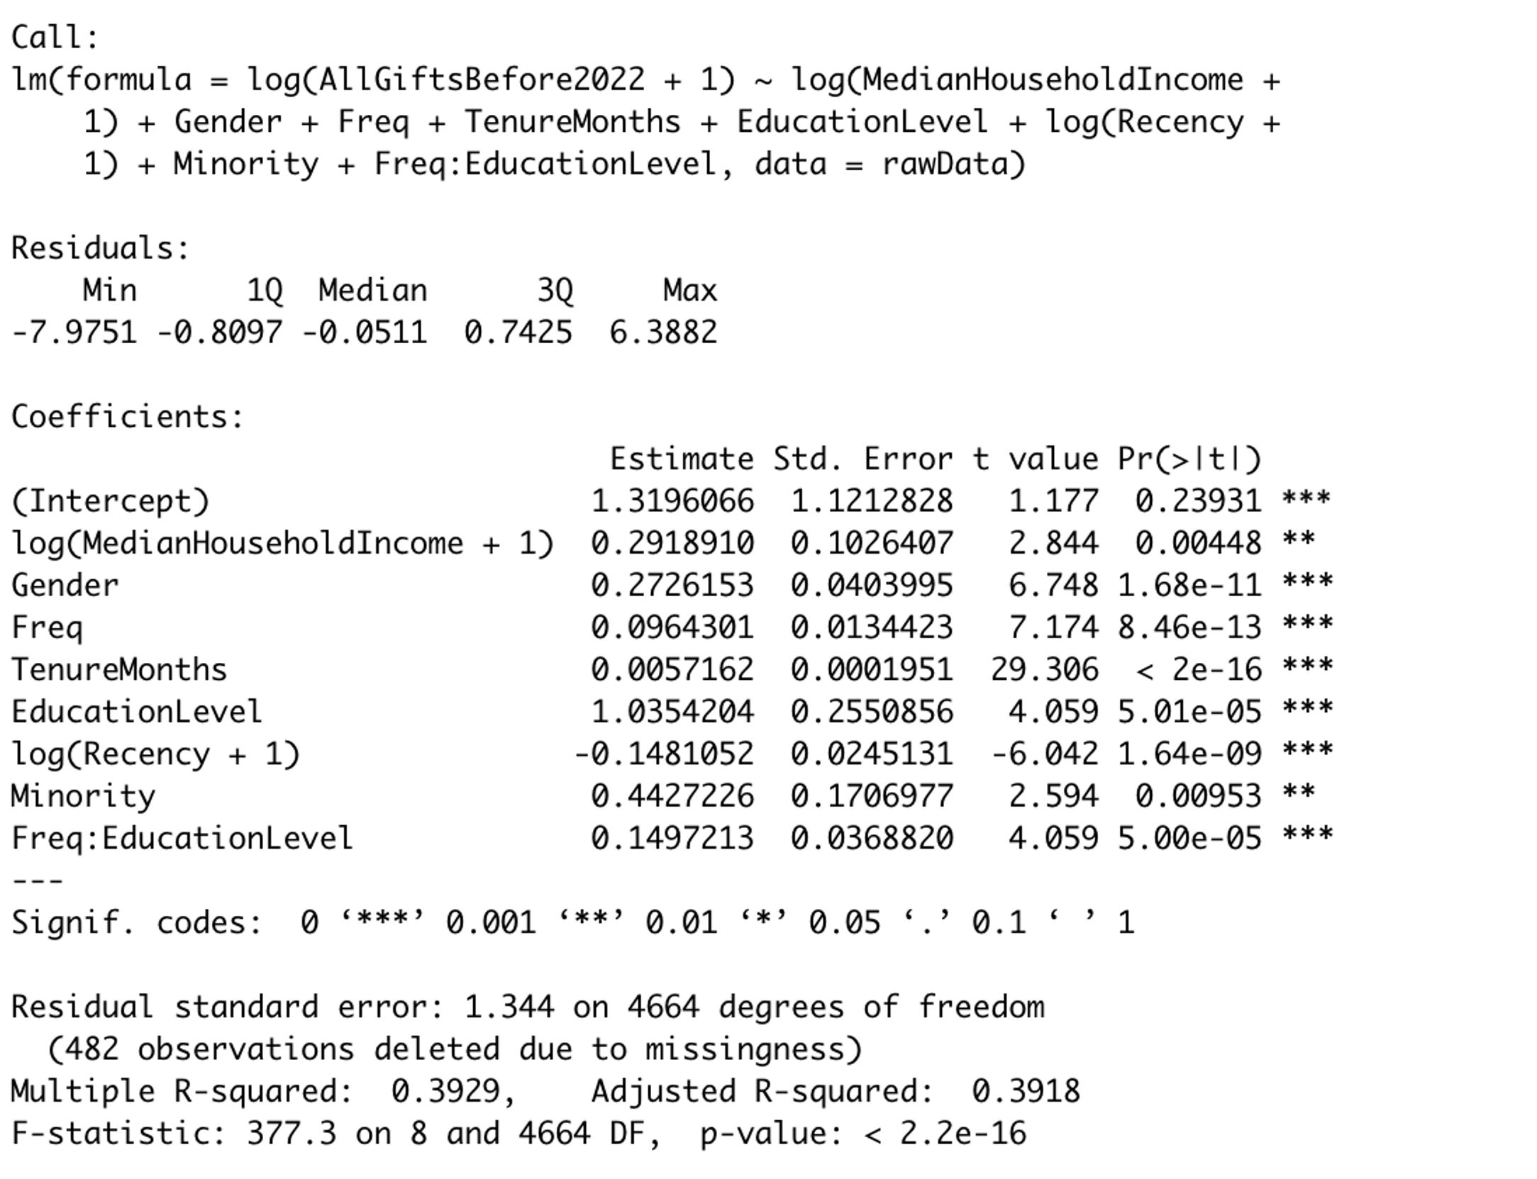
Regression result

Slide 15
RFM
The segmentation based on RFM model is as follows:
label |  | Recency | Frequency | Monetary Value | Description | Percentage
1 | Core | 1 | 1 | 1 | Best customer | 6.98%
2 | Loyal | 0 | 1 | 1 | Loyal | 2.06%
3 | Whales | 1 | 0 | 1 | high value | 2.58%
 |  | 0 | 0 | 1
4 | Promising | 1 | 1 | 0 | potential | 17.75%
 |  | 0 | 1 | 0
5 | Rookies | 1 | 0 | 0 | new user | 23.41%
6 | Slipping | 0 | 0 | 0 | lost | 47.22%

Slide 16
RFM
 | core | loyal | whales | promising | rookie | slipping
 | group1 | group2 | group3 | group4 | group5 | group6 | All
Female | 33% | 21% | 34% | 41% | 54% | 51% | 47%
Male | 67% | 79% | 66% | 59% | 46% | 49% | 53%
Rural | 1% | 1% | 4% | 2% | 2% | 2% | 2%
Suburban | 91% | 92% | 91% | 92% | 90% | 90% | 90%
Urban | 8% | 7% | 5% | 7% | 8% | 8% | 8%
MinAbove* | 77% | 78% | 68% | 73% | 73% | 73% | 73%
MinBelow* | 23% | 22% | 32% | 27% | 27% | 27% | 27%
MinAbove*: Minority above average
MinBelow*: Minority below average

Slide 17
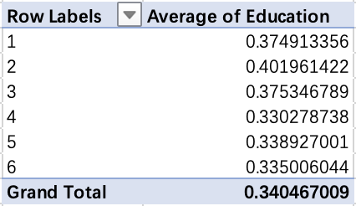
RFM
High education percentage:
Overall, males have received higher education
Donors with higher education tend to be more loyal to charity
 | core | loyal | whales | promising | rookie | slipping | All
 | group1 | group2 | group3 | group4 | group5 | group6
Female | 48% | 57% | 51% | 37% | 44% | 41% | 42%
Male | 63% | 65% | 66% | 45% | 46% | 48% | 50%

Slide 18
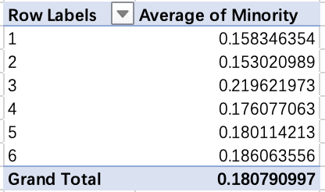
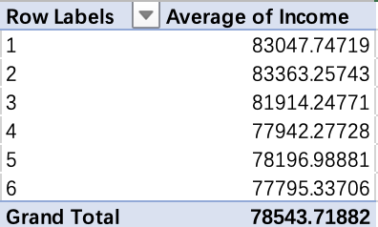

Slide 19
Segments
Core & loyal -
Whales & promising -
Rookie (New Donor) - more personalization for female (keep female rookie, acquisition male rookie)
Slipping – maintain the current strategies
Conversion / funnel – eg. Convert from rookie to promising to whale
Incorporate education, income, tenure, and minority

Slide 20
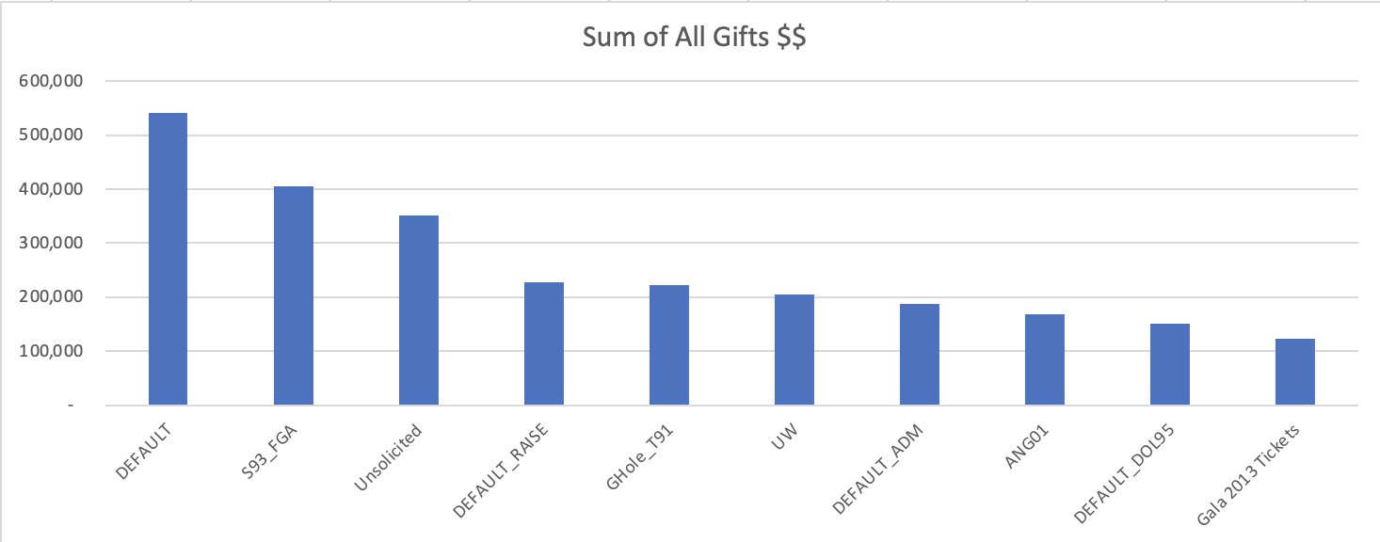
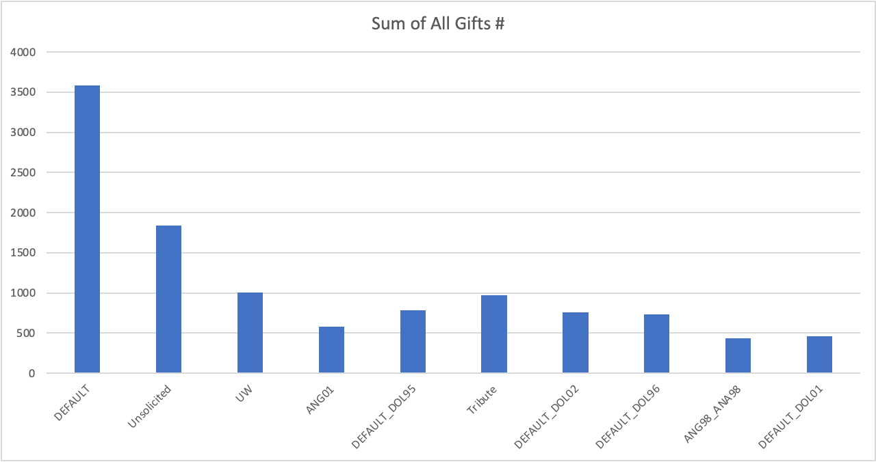
Descriptive analysis

Slide 21
Campaigns
Insights-
Education level
Minority
Attract female donors to donate more
Keep the male donors to keep donating
….
For each identified donor segment, design a promotional plan to target additional individuals who “resemble” members of the segment.
Christmas / Easter / Quarterly Plan
Social media -
Official website (email sign up) - testimonials
Mail / Email Marketing (target to older ppl?) –
SMS?
Increase the sustainability of gift – website optimization
Real-time donation update with donor’s name

Slide 22
Summary for promotions
Sports Gatherings
Target male donors who tend to donate larger amount and more frequently.
Diversity and Inclusion
Target minority groups to celebrate diversity month/anniversary.
Monthly donation plan & Company event
Target higher-income donors who are likely to donate larger amount and consistently.
College club event
Target higher-education donors who donate twice more.
Notes:
Summarize promotions we recommended.
Sport gatherings: More male-focused activities eg. Sports Gathering . Target male donors…, based on descriptive and regression analysis.
Encourage to sign up for the monthly recurrent plan with rewards. Upgrade current monthly donation plan with additional rewards and collab with local company for DEI event to target
Collaborate with DEI team from local Rochester companies University Club or Programs Include diversity and inclusion in newsletters and events to
Create new types of newsletters focusing on Diversity Content, eg. Martin Luther King, Indigenous day

